Slide 1

Enhancing Care Through Community Connection
“Share more. Care together. Stay connected”
Introducing the ODJJ to First Nations Communities
Notes:
This presentation will familiarize you with the Our Dementia Journey Journal if you are a caregiver or care provider of a person living with dementia

Slide 2


Agenda
1
Introduction /Background
2
Key Messages & Features
3
Next Steps
4
Q&A
2
Notes:
Here is an overview of what will be discussed today

Slide 3
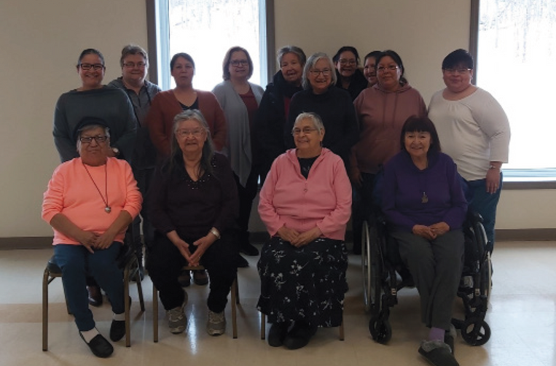

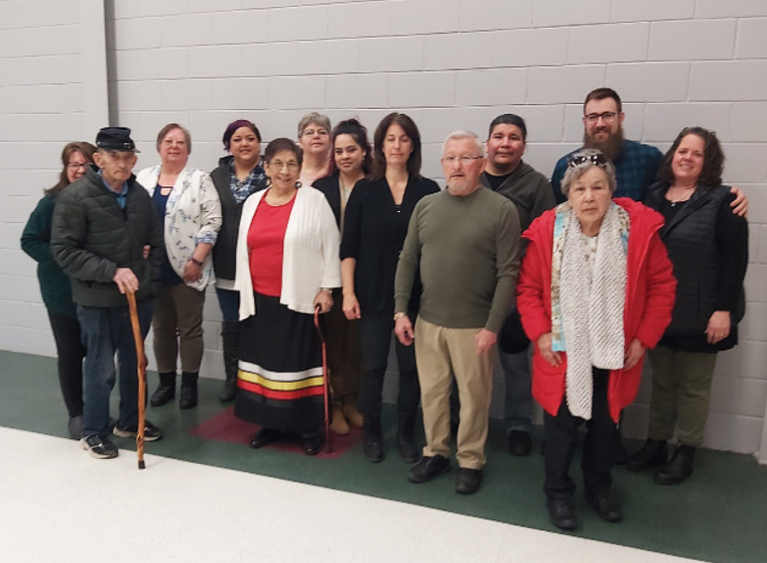
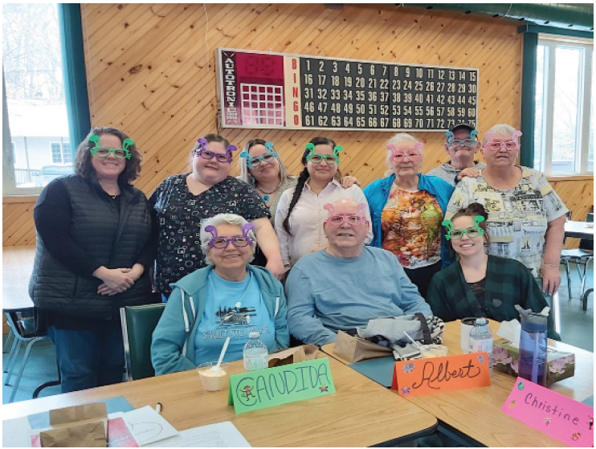
FIRST NATIONS PARTNERSHIPS
First Nation communities along the North shore identified an Interest for culturally safe dementia resources.
ALL STAGES OF THIS PROJECT WERE GUIDED BY THE OCAP PRINCIPLES (OWNERSHIP, CONTROL, ACCESS AND POSSESSION)
3
Notes:
First Nation communities along the North shore identified an Interest for culturally safe dementia resources. We were able to work together with SE Health's First Nations, Indigenous, and Metis Program with support from Maamwesying North Shore Community Health Services to co-design/adapt a dementia care resource with three communities
Sagamok, Thessalon and the Sault Ste Marie Indigenous Friendship Centre.
All stages of this project in collaboration with First Nations were guided by OCAP principles

Slide 4

COMMUNITY INVOLVEMENT
With the support from Maamwesying and the Senior Patient Advisory Council the Our Dementia Journey Journal was designed to be culturally safe for North Shore communities.
5
Notes:
With the support from Maamwesying and the Senior Patient Advisory Council the ODJJ was designed to be culturally safe for North Shore communities.

Slide 5
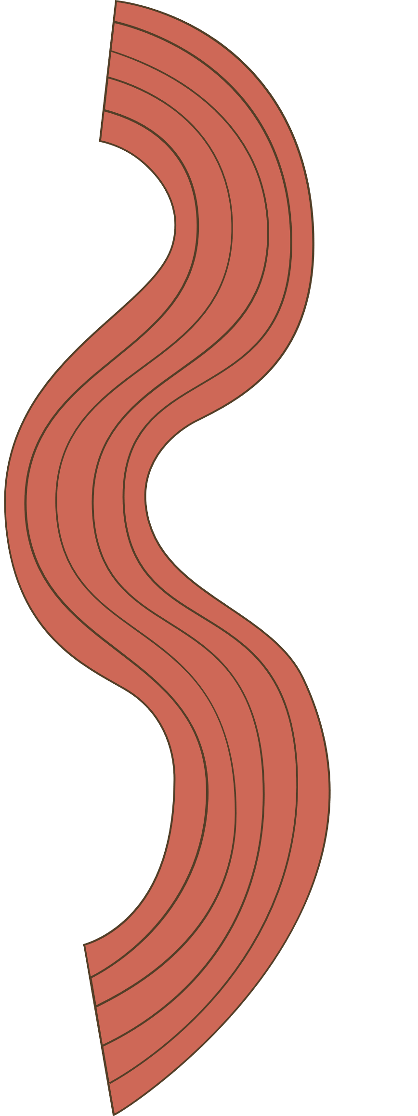
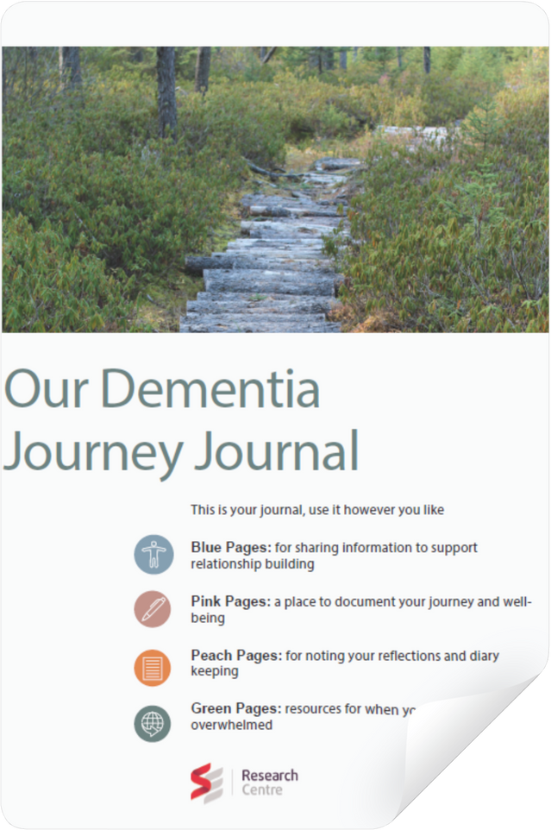
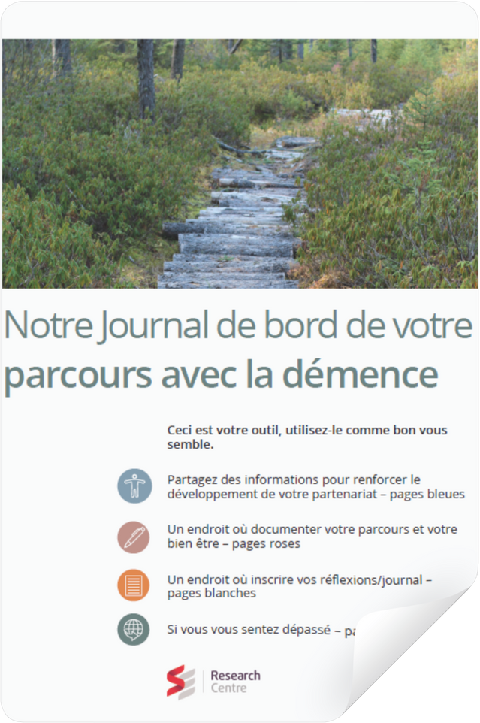
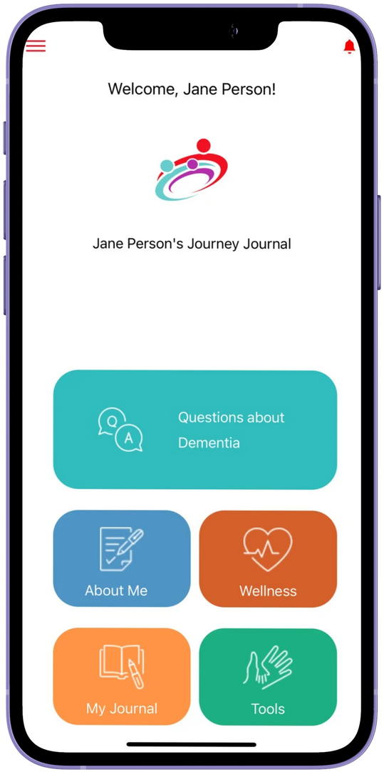
OUR DEMENTIA JOURNEY JOURNAL (ODJJ)
This resource was co-designed with and for caregivers, care providers and PLWD to support relationship building and communication along the dementia journey and then adapted for First Nations communities
4
Notes:
The result of this collaboration was the Our Dementia Journey Journal
This resource was co-designed with and for caregivers, care providers and PLWD to support relationship building and communication along the dementia journey and then adapted for First Nations.
The ODJJ is available as a paper-based resource and mobile application in English and French. The mobile app is available on Apple and Google app stores.
Here you can see a visual of the paper tool and mobile application. As you may see there is the paper version for everyone here that would like one and feel welcome to download the app in app stores.

Slide 6

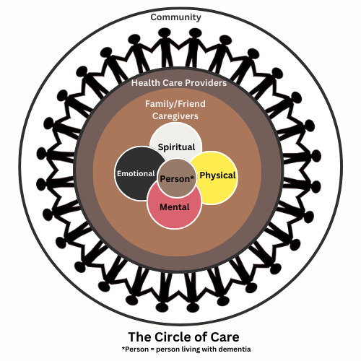
Care is not the responsibility of one person--it’s a shared circle.
The Circle of Care is centred around the person living with dementia, and those that care for them.
Including: caregivers, health care providers, community members, helpers, knowledge keepers, Elders and Traditional healers
6
Notes:
In the ODJJ we use this term, Circle of Care, to describe relationships between everyone that supports the person living with dementia because it is not the responsibility of one person--its a shared circle.
When we say the Circle of Care, we are talking about community support for the PLWD-- family, friends, elders, PSWs, nurses, neighbours, Elders, knowledge keepers and Traditional healers
There is knowledge and memory sharing, connection and compassion, physical, mental, emotional and spiritual support.
This is a way of living and caring for each other that is nothing new to First Nations people.

Slide 7

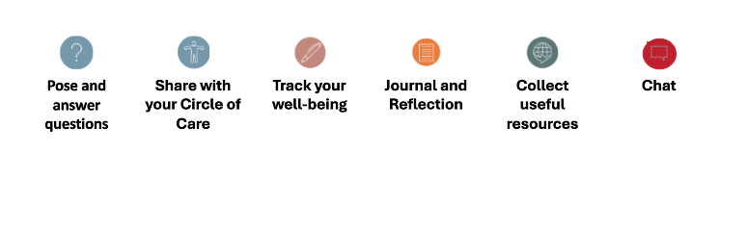
ODJJ FEATURES
01
02
03
04
05
06
(Only available on
App Feature)
7.
Notes:
There are 6 main features of the ODJJ
1. Ask/Answer questions
2. Series of activities to share information and get to know one another
3. A section to track well-being
4. A section to journal/reflect
5. A place to access and collect resources
6. in the app, there is a live chat features where caregivers and providers can exchange messages.
This all Aids in tracking symptoms, sharing care details, and honour the PLWD.

Slide 8

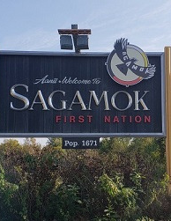


ODJJ Trial Use
The ODJJ was trialed between June 2024 to January 2025 in:
Garden River
Sagamok Anishnawbek First Nation
Thessalon
8
Notes:
The three communities included in the ODJJ deployment were Garden River, Thessalon, and Sagamok participating in a trial use of the ODJJ
Establishing a collaborative relationships were vital to supporting the outreach and championing of the tool. This helped to build trust and willingness to try the resource tool.
I would like to share some of our learnings from the trial period and how this may support use of the ODJJ in your communities.

Slide 9
KEY MESSAGES
The ODJJ helps to:
Provide person-centered care
Support caregiver well-being
Provide community specific support
9
Notes:
Through our learnings, we have identified 3 key messages of how the ODJJ can support a community's needs:
1. Supporting Person Centered Care
2. Support caregiver well-being and
3. Provide community specific support.
I will now go into depth on these key messages and some of the features that support use.

Slide 10

One caregiver talked about the way the ODJJ can support caregivers and care providers through focusing on person-centred care; supporting the quality of life for the person living with dementia.
““The ODJJ helps keep focus on quality of life and care … Also helpful for future PSW's coming into care to understand who they [persons living with dementia] are as a person and how much we care about them"- Caregiver
PERSON-CENTERED CARE
10
Notes:
I'd like to start with Person-Centered Care.
Here is a quote from a First Nations caregiver:
**Read QUOTE**
This highlights how the ODJJ can support caregivers and providers to focus on Person-Centred Dementia Care, supporting quality of life.

Slide 11
During one of the first community sessions a daughter caring for her mother who was living with dementia shared that her mother never liked to see dishes in her sink, it was upsetting to her and often a trigger. The daughter shared if care providers reviewed ODJJ, they will learn more about her mother and the things that are important to her.
- Doris Warner
SUPPORT PERSON-CENTERED CARE
11
Notes:
Doris describes how having a greater understanding of the person living with dementia's preferences can guide care, being identified from using the ODJJ.
**Read the quote**
Using information like this can help providers know the needs/preferences of the PLWD and avoid keeping dishes around.

Slide 12

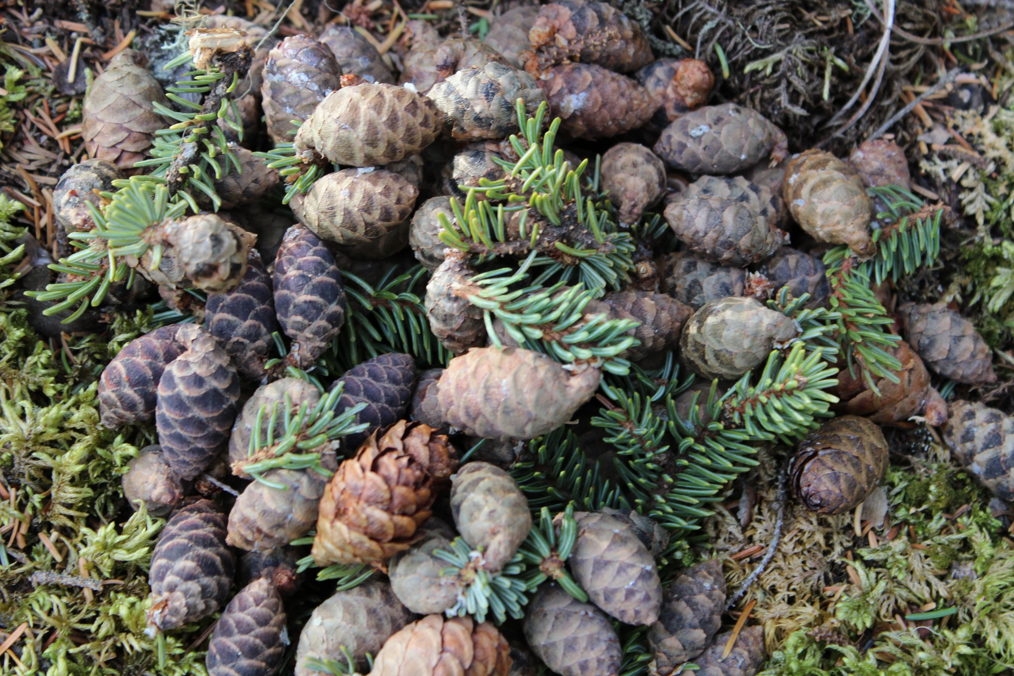
Caregivers highlighted personalized interactions can promote smoother transitions and reduce anxieties, especially in later stages of the dementia journey.
The All About Me Section outlines the PLWD & the caregivers:
Preferences
Behaviours
History
Interests
For one of the participants it was noted that the care provider can have a better understanding of the PLWD’s likes/dislikes.
KEY FEATURE #1- ALL ABOUT ME
12
Notes:
The first key feature to support person-centered care identified was the " All About Me" section, as it supports care providers to understand the person beyond the diagnosis.
Things such as: what brings someone joy, what preferences they have, foods they like or to avoid, or even how the person likes to start their mornings--In essence, softening the anxiety that could potentially arise when caring for someone new.

Slide 13
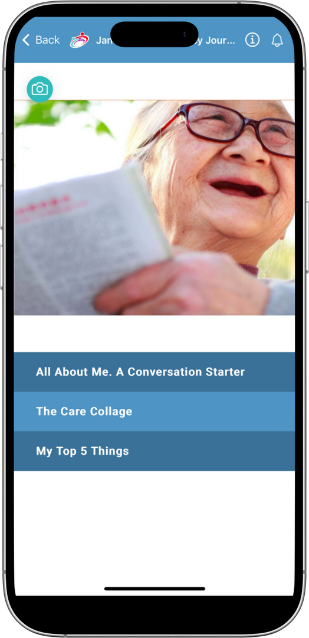
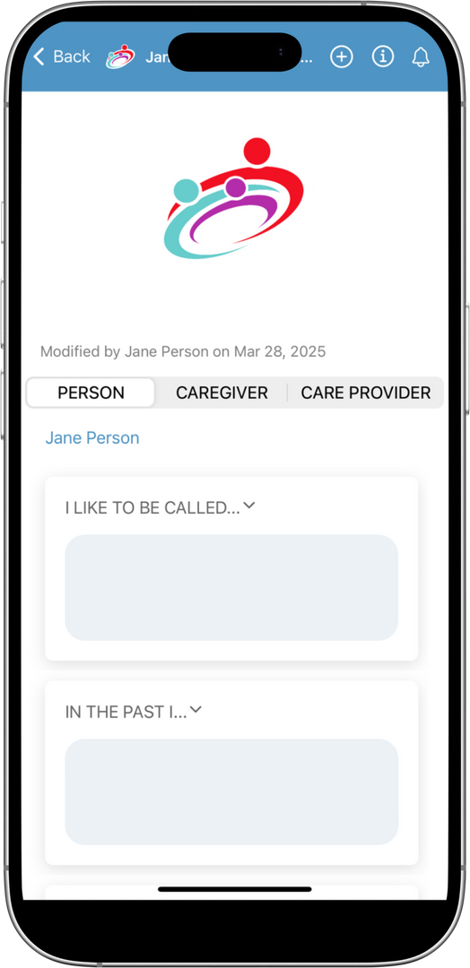
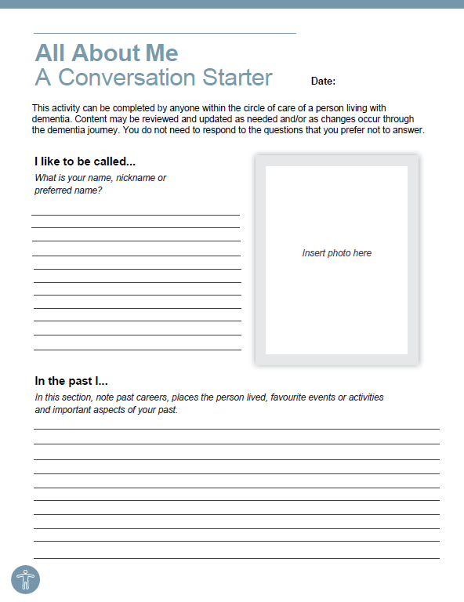
ALL ABOUT ME
13
Notes:
On the left, you're seeing the All About Me section, on the mobile app.
On the right is the paper-based version.
Whether it's written down or shared on the app, the choice is up to the family.

Slide 14
“...not only does it focus on the caregiver and what works for them [PLWD] but also I noticed that it is also for the caregiver as myself and then how it reminds me that I need to take care of myself." - Caregiver
SUPPORTING CAREGIVERS WELLBEING
14
Notes:
The next message I would like to highlight is how the ODJJ supports caregiver wellbeing. As caregivers are focused on their loved ones; stress, exhaustion and burnout can go unnoticed.
*READ QUOTE*
This caregiver shares their experience through using the Well-Being section, and how a quick check in with herself supported her well-being
This feature supports community and collaboration through being able to share these check-ins with the Circle of Care.

Slide 15

A space for members of the Circle of Care to communicate care needs/and or concerns such as:
Address Concerns
Day to day necessities
Increase caregivers ability to check-in with themselves, emotionally & mentally
Document changes
Being able to advocate for their loved ones, and oneself
Enhances understanding & communication between the circle of care
KEY FEATURE #2- WELL-BEING COMMUNICATION
15
Notes:
The Well-Being Communication Section supports community and collaboration as it is a space for caregivers to share things they may be concerned with and identify what types of support they need with their care providers.

Slide 16
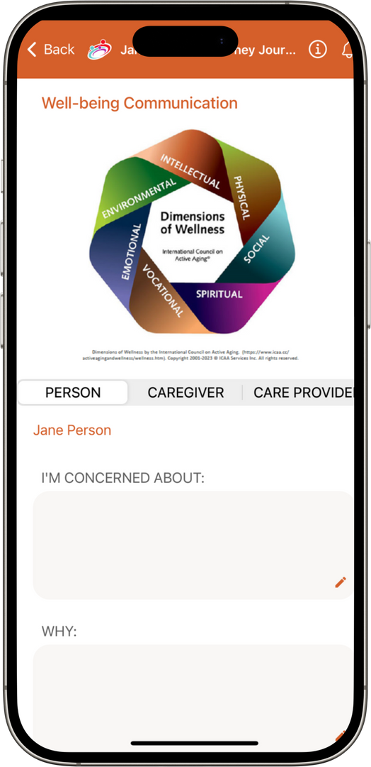
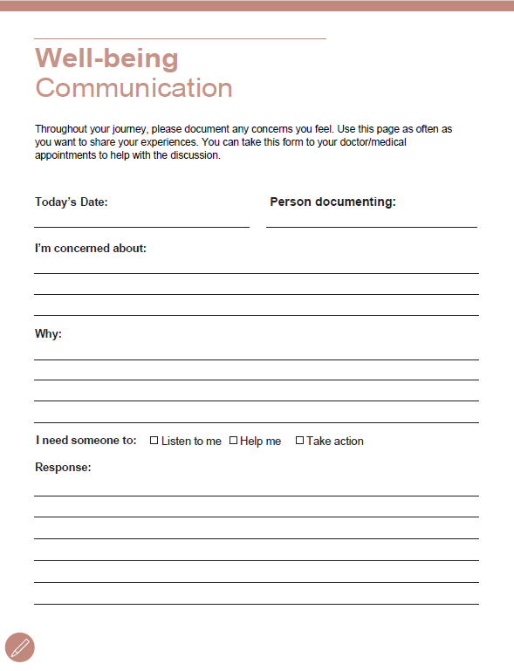
WELL-BEING COMMUNICATION
16
Notes:
Shown here are some screen shots of the app version and paper-based version of the Well-Being Communication Section. As you can see, there are clear spaces for caregivers to record their concerns, the support needed and come up with a plan with their providers for support.

Slide 17
3.COMMUNITY SPECIFIC SUPPORT
“... whether they continue to use it or not, it has opened up the doorway to have that conversation around isolation... During a visit in the home of a participant the community champion shared now that they know about the caregivers’ feelings of isolation that they can rally help and support... sharing that they can do things to support the caregiver and make sure that they are cared for and that they have visitors...” - Doris Warner
17
Notes:
The last message that I would like to highlight is how the ODJJ can provide community specific support:
Here is another quote from Doris
**Say quote**
The ODJJ strengthened supportive relationships in the community through being a tool that helps start conversations about, and reflection on the support needs of caregivers and people living with dementia through sharing how the importance of opening up conversation leads to further support.

Slide 18

NEXT STEPS
Keep the ODJJ as a FREE, Publicly available resource
Continue to share the ODJJ with more communities across Canada to support caregivers, care providers of persons living with dementia
18
Notes:
Now that I have shared our journey with the ODJJ and some of the key messages and features, I would like to share with you some next steps.
The trial period helped inform how the ODJJ can be introduced and used in First Nations communities, we are now ready to make it available to more communities across Canada in collaboration with SE FNIM Program.
The ODJJ will continue to be a FREE, publicly available resource

Slide 19



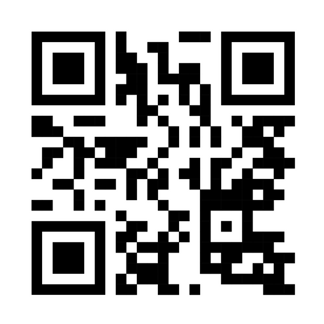
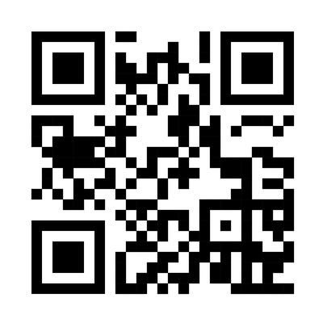
INTERESTED IN BRINGING ODJJ TO YOUR COMMUNITY OR LEARNING MORE?
Visit our website www.odjj.ca for resources to support implementation or use of ODJJ
Contact Doris Warner, SE Health First Nations Inuit and Métis Program, Community Engagement Liaison (DorisWarner@sehc.com)
Scan to Download from the App Store
Scan to Download from the Google Play Store
20

Slide 20


Acknowledgements
We would like to gratefully acknowledge the contributions from the Maamwesying Sr PAC, Elders and community members from
Garden River, Sagamok and Thessalon First Nations
Sault Ste Marie Indigenous Friendship Centre, Bloomington Cove,
Collaborators:
21
Notes:
We would like to gratefully acknowledge the contributions from the Elders and community members from Sagamok and Thessalon First Nations, Sault Ste Marie Indigenous Friendship Centre, Bloomington Cove, and all other individuals across Canada who participated in the co-design and trial of Our Dementia Journey Journal.
We also extend our gratitude to our partners:
- SE FNIM Program (particularly Doris Warner and Corey MacKenzie)
- Maamwesying North Shore Community Health Services
Funders:
- SE Health
- Public Health Agency of Canada

Slide 21
Thank you!
23

