Slide 1

Our Dementia Journey Journal
“Share more. Care together. Stay connected”
An Overview of ODJJ for Organizations and Groups

Slide 2

Agenda
ABOUT OUR DEMENTIA JOURNEY JOURNAL
KEY MESSAGE & TESTIMONIALS NEXT STEPS
Q&A

Slide 3


THE OUR DEMENTIA JOURNEY JOURNAL
An interactive resource
Co-designed, tested and refined
with and for people living with dementia, family/friend caregivers, and healthcare providers
Notes:
Generated by Copilot The "Our Dementia Journey Journal" is an interactive resource that has been co-designed with input from individuals living with dementia, their caregivers, and healthcare professionals. This collaborative approach ensures that the journal meets the real needs of its users, making it a practical tool for enhancing care and communication. The photograph of the group highlights the community aspect of this initiative, reinforcing the idea that support comes from shared experiences and insights. ______
HISTORY
- The ODJJ idea came from an initial caregiver steering committee with the Alzheimer’s Society of Canada which identified that more support was needed for communication and relationship building between caregivers and care providers along the dementia journey. They saw this as a gap: there is a wide range of supports for providers to provide person-centred care for and with PLWD, but that relationship between providers and caregivers, they thought, needed help.
Therefore, we did a series of co-design workshops with caregivers and providers (experts by experience) to develop the ODJJ

Slide 4


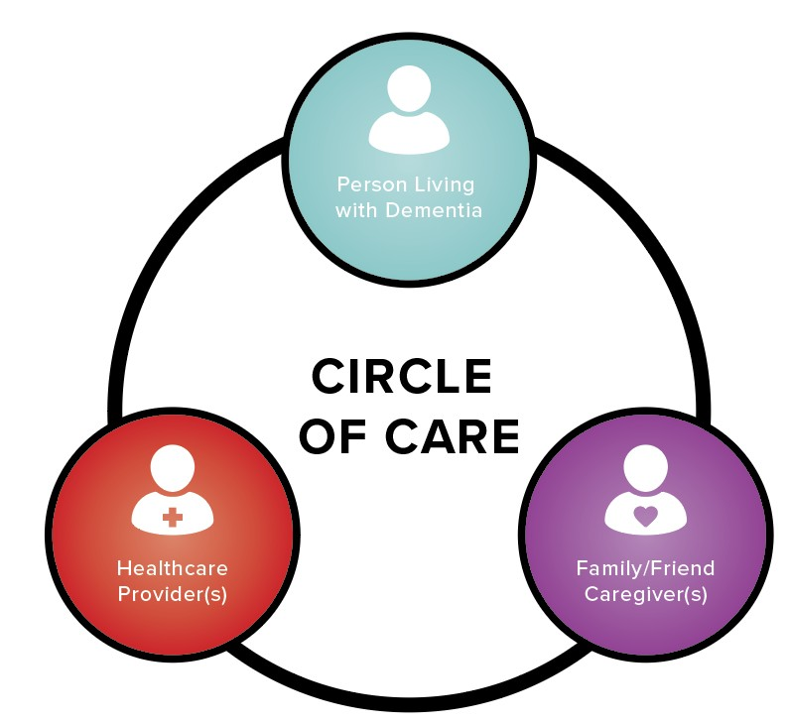
The Circle Of Care
A Circle of Care is made of the relationships between family and friends in caregiving roles, health care providers and a person living with dementia.
The ODJJ aims to strengthen the relationships specifically between caregivers and health care providers as they support a person living with dementia.

Slide 5

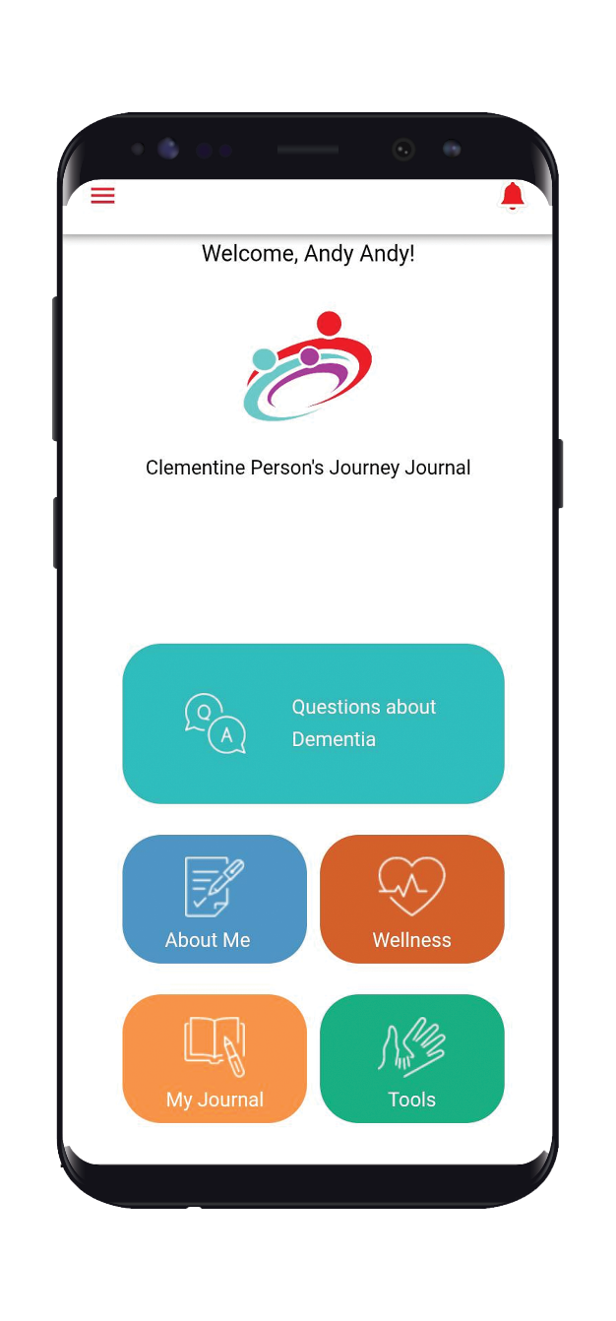
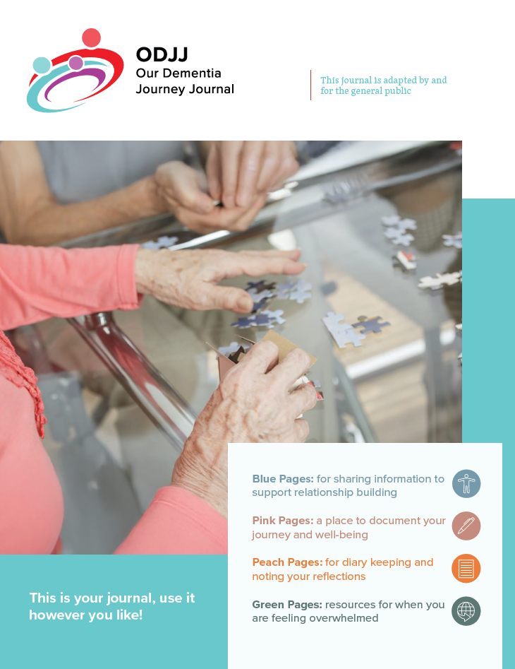
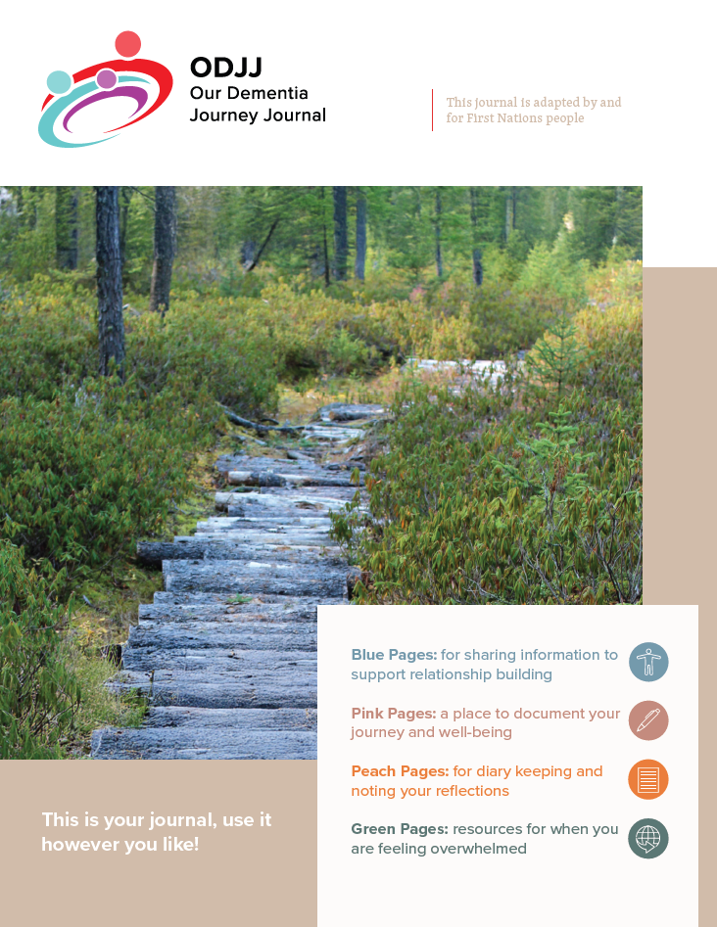
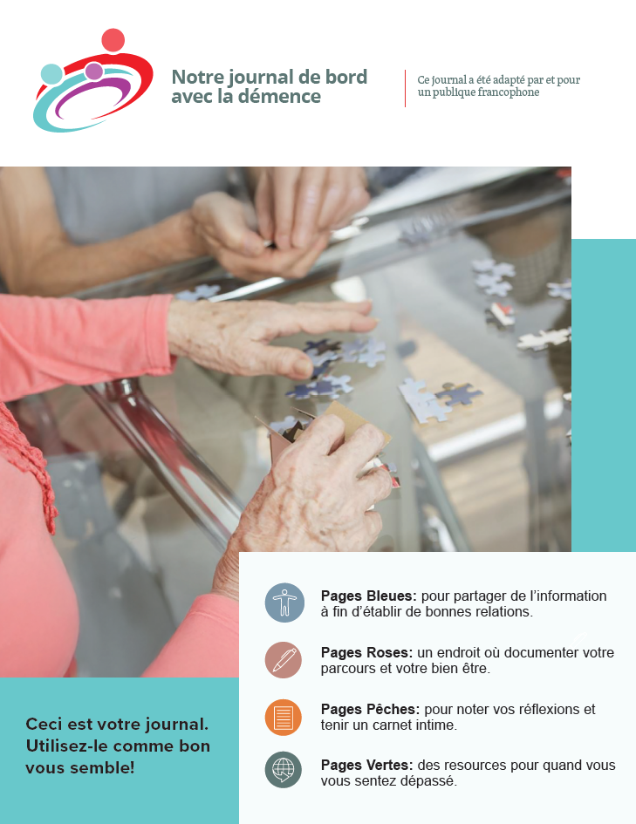
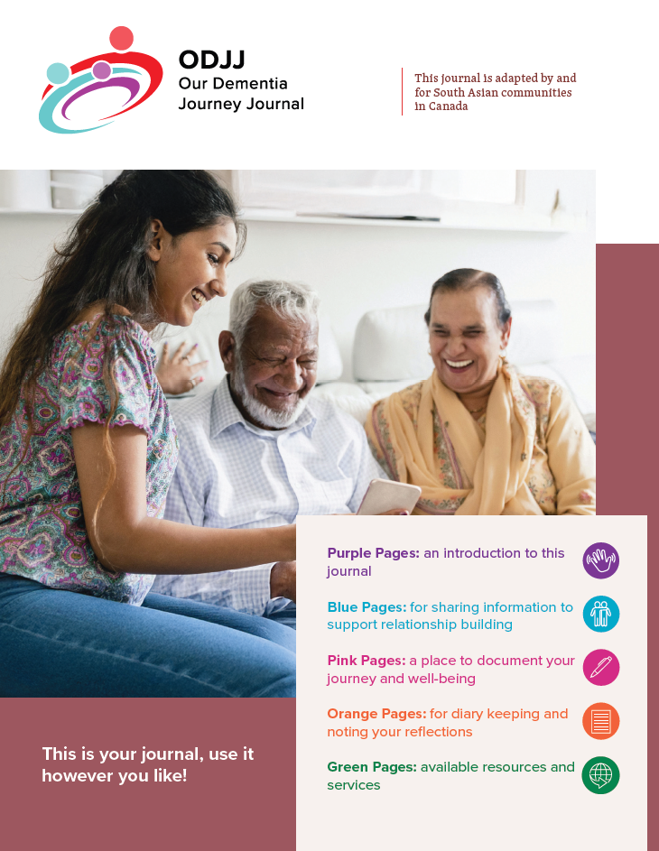
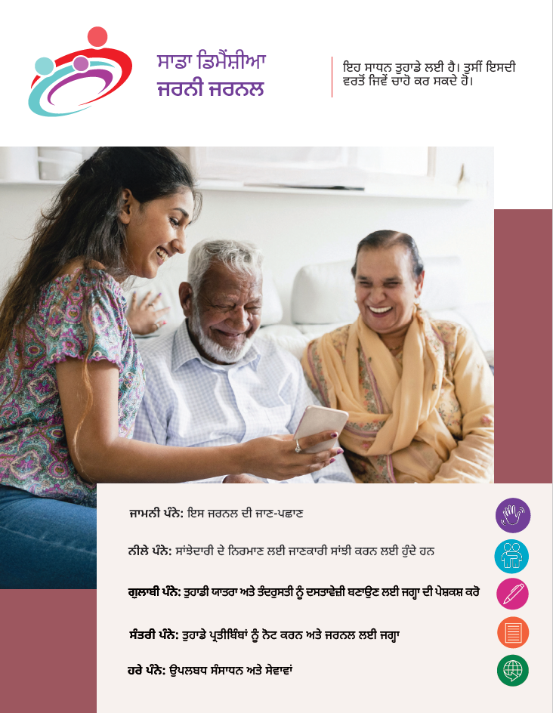
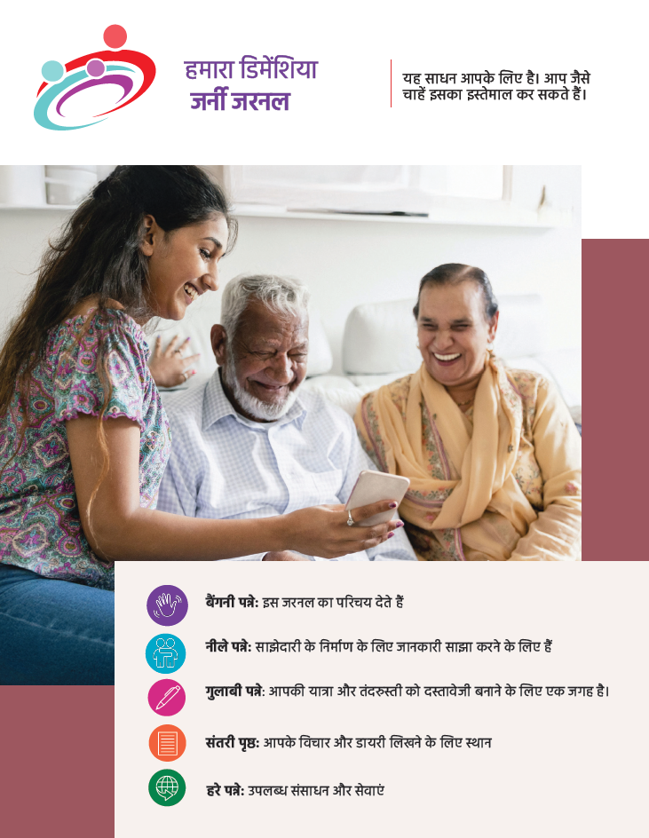
ODJJ VERSIONS & LANGUAGES
Formats – App (Apple & Android), Paper Based
Versions - Generic, First Nations, South Asian Languages - English, French, Hindi, Punjabi

Slide 6

ODJJ FEATURES
Ask: Record and answer questions within the Circle of Care.
Share: Share words, pictures and videos with the Circle of Care.
Track well-being: Monitor wellness over time.
Reflect: Journal and share notes or reflections.
Resources: Collect information from sources like the Alzheimer Society.
Chat: Send and receive messages and updates within the Circle of Care.

Slide 7

Validation & preparation for spread
The ODJJ was launched in 7 diverse communities in Ontario and Alberta between March 2024 and January 2025.
Continuing care/long-term care homes
First Nation communities,
South Asian community organizations, adult day program)
Notes:
Generated by Copilot The ODJJ initiative is set to launch in seven diverse communities across Ontario and Alberta, focusing on various care settings, including long-term care homes and community organizations. This rollout is crucial for validating the journal's effectiveness and preparing for broader implementation. The photograph of community interactions emphasizes the initiative's commitment to inclusivity and support for all involved in dementia care. ______
With funding from PHAC and SE health, we did a trial of the ODJJ in three settings, and 7 communities in ON and AB

Slide 8
KEY MESSAGES:
The ODJJ offers a variety of tools to:
Support caregivers and their well-being
Learn about dementia & dementia care
Provide person-centered care
Access dementia care resources (includes resources for cultural communities such as First Nations, French, South Asian communities)
De-stigmatize Dementia through conversations

Slide 9
1. Support caregivers and their well-being
“ANYTHING TO HELP HER CARE AND HELP THE PEOPLE WHO ARE CARING FOR HER, I FEEL BETTER ABOUT, AND MY WIFE FEELS BETTER ABOUT IT AS WELL. THERE’S SO MUCH GUILT AROUND LOOKING AFTER FAMILY MEMBERS … IT WOULD ENHANCE MY QUALITY OF LIFE. BECAUSE CERTAINLY WHEN MY MOM IS DOING BETTER, I FEEL BETTER.” - Caregiver

Slide 10

KEY FEATURE #1
Bi-Weekly Check-In
A space for members of the Circle of Care to check-in with themselves:
Complete every 2 weeks or whenever works for you
Monitor your score over time
Seek support when you notice your score is declining (e.g. support groups, other sections of ODJJ)

Slide 11
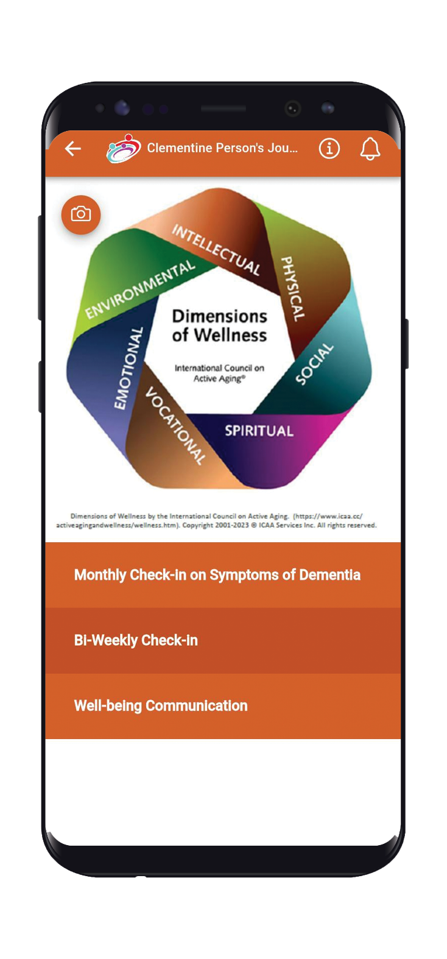
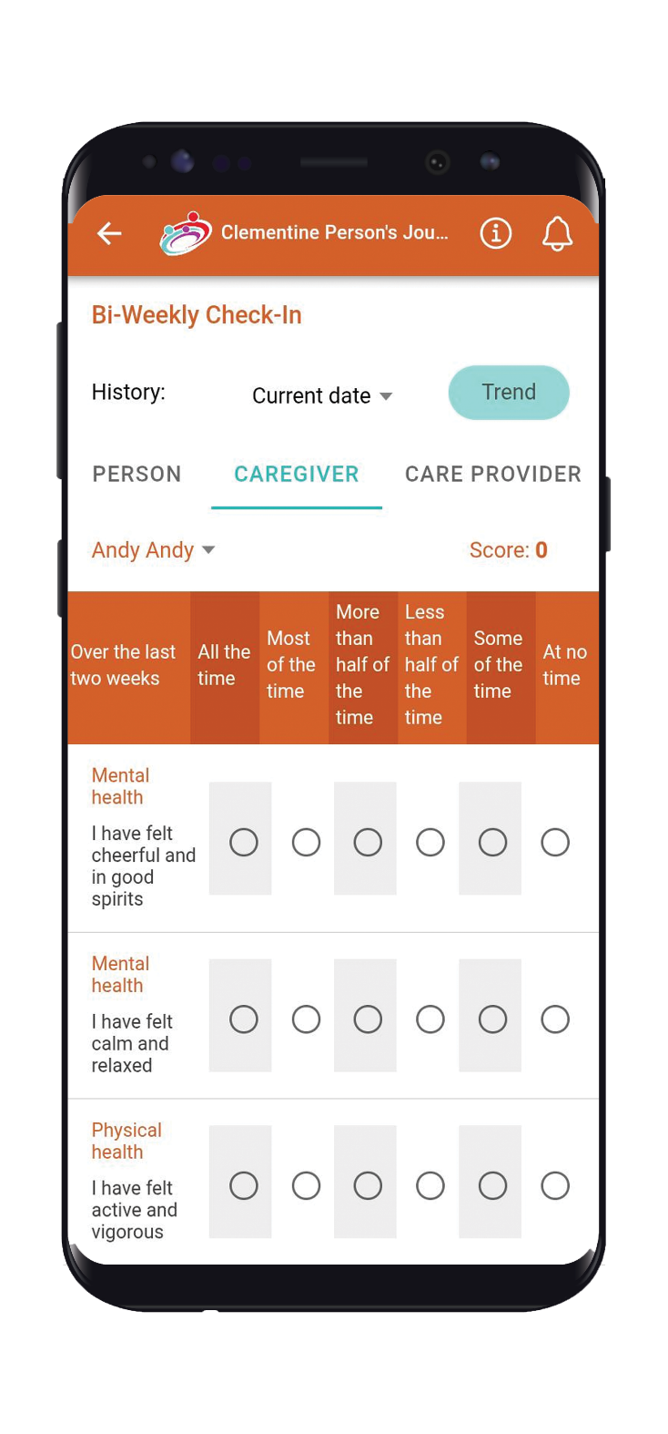
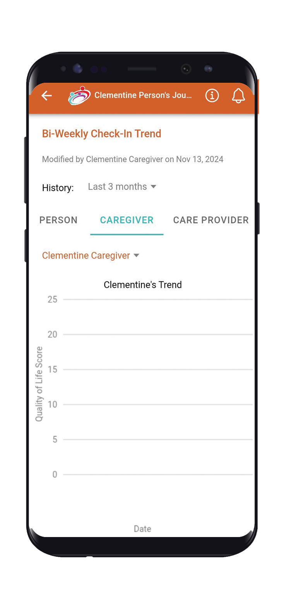
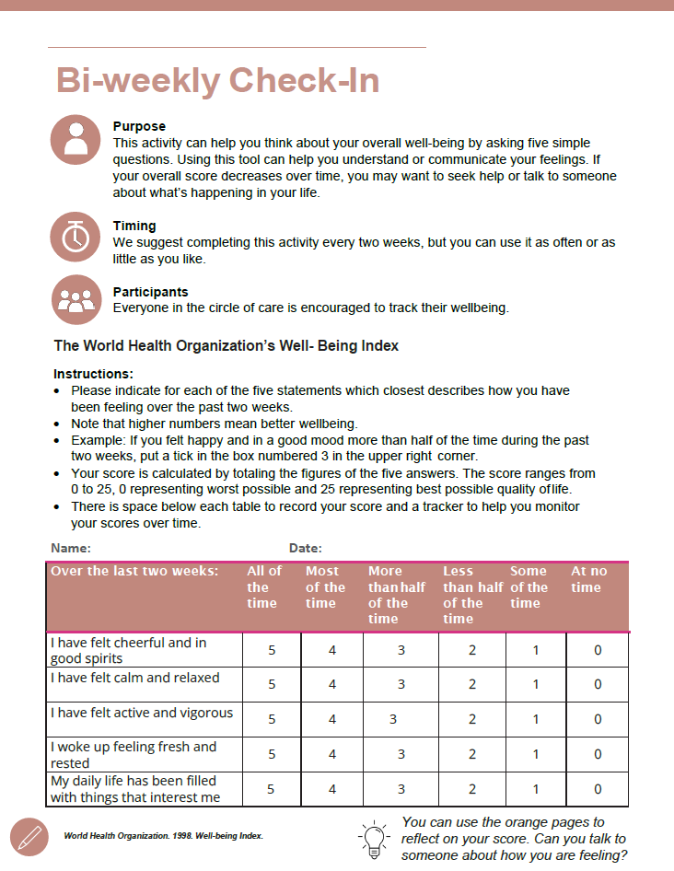
Bi-Weekly Check-In

Slide 12
2. Learn about dementia and dementia care
“I could say [in the chat function of the app], ‘His blood sugar was really low this morning and he didn’t eat much breakfast and he’s kind of in a mood and he’s a bit grumpy.’” – Caregiver

Slide 13
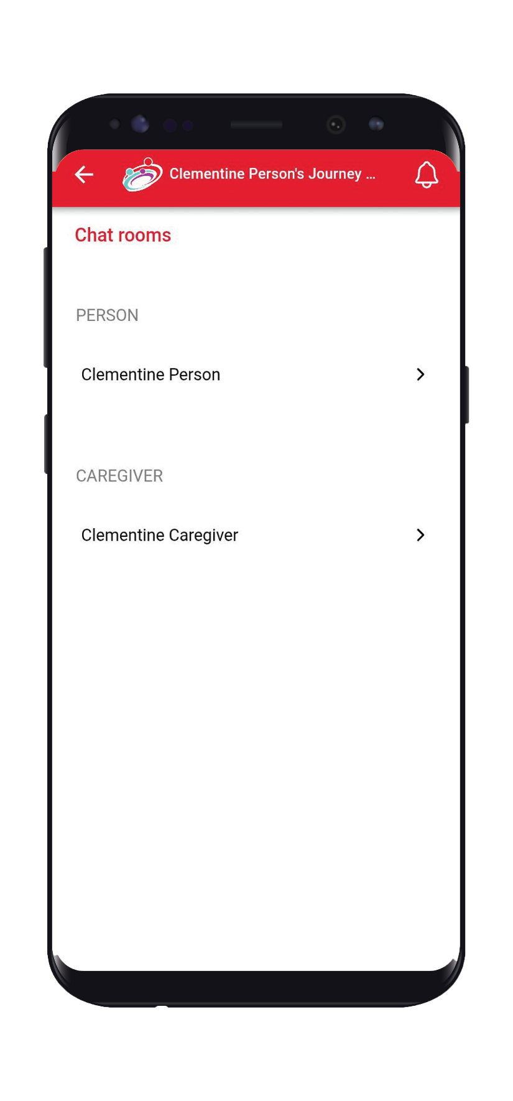
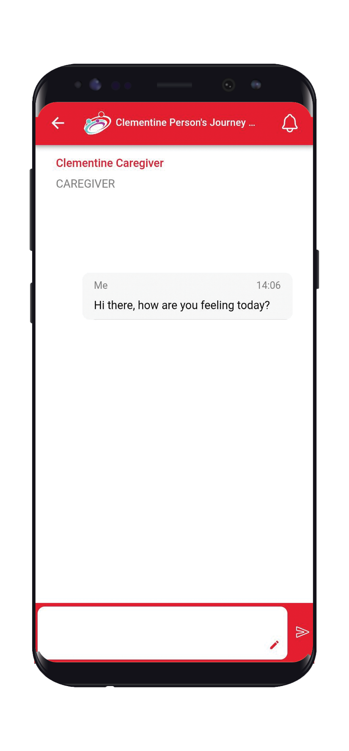
KEY FEATURE #2
Chat
A space for members of the Circle of Care to instantly message:
Updates to care providers (e.g. sleep, blood sugar, etc.)
Day to day necessities
Communicate with long-distance caregivers (e.g. siblings or other family members in a different city/country)
Document changes
Utilizing this feature can support communication across the Circle of Care.

Slide 14
3. Provide person-centered care
“My mom was still playing the piano, and it was things like that. When there’s musical entertainment in there, I don’t ever want her to miss it” - Caregiver
Family members play a vital role in helping staff provide person centered care by sharing what they know about the person living with dementia.

Slide 15
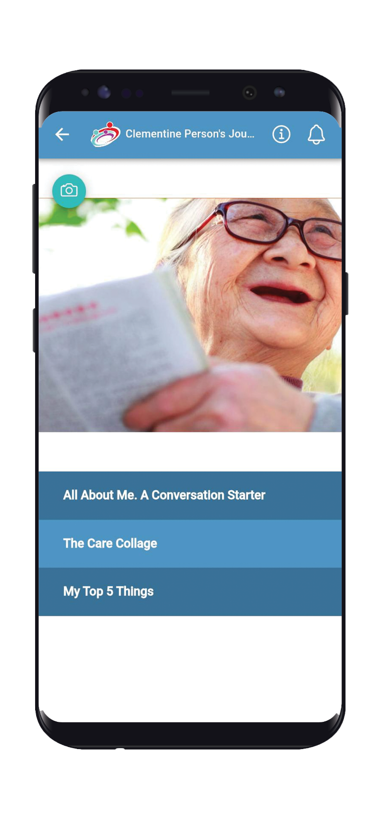
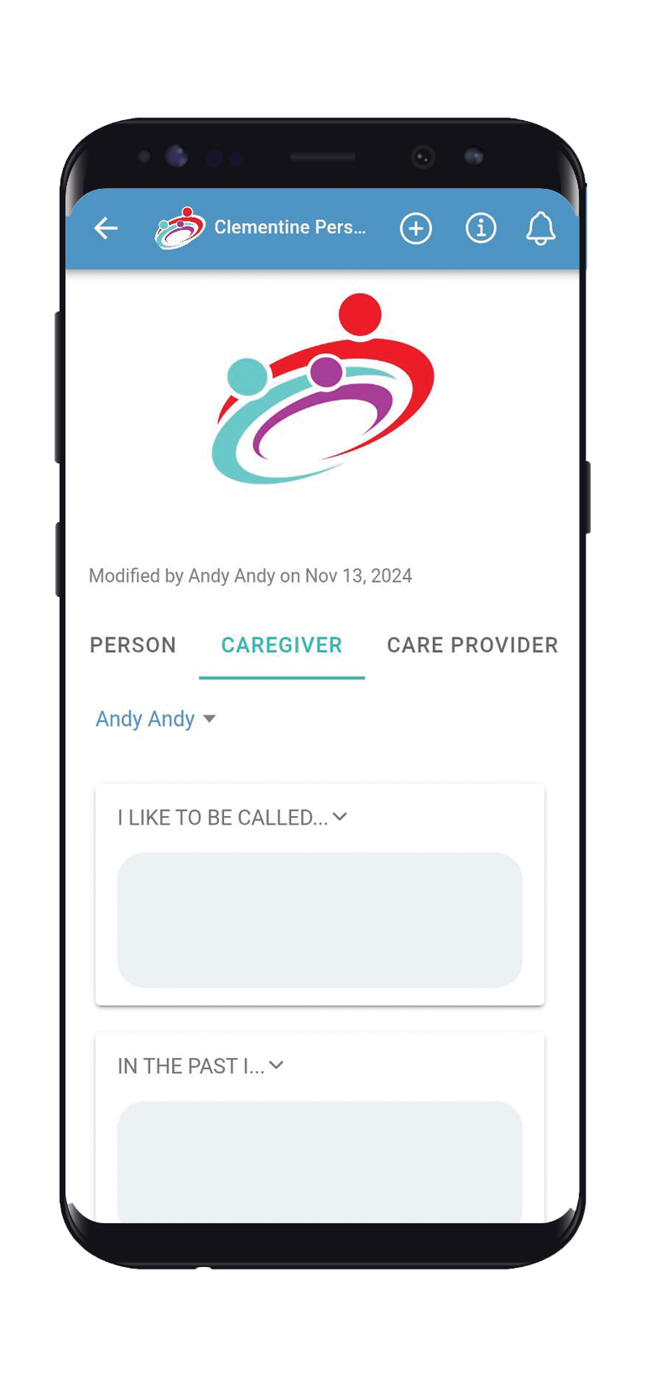
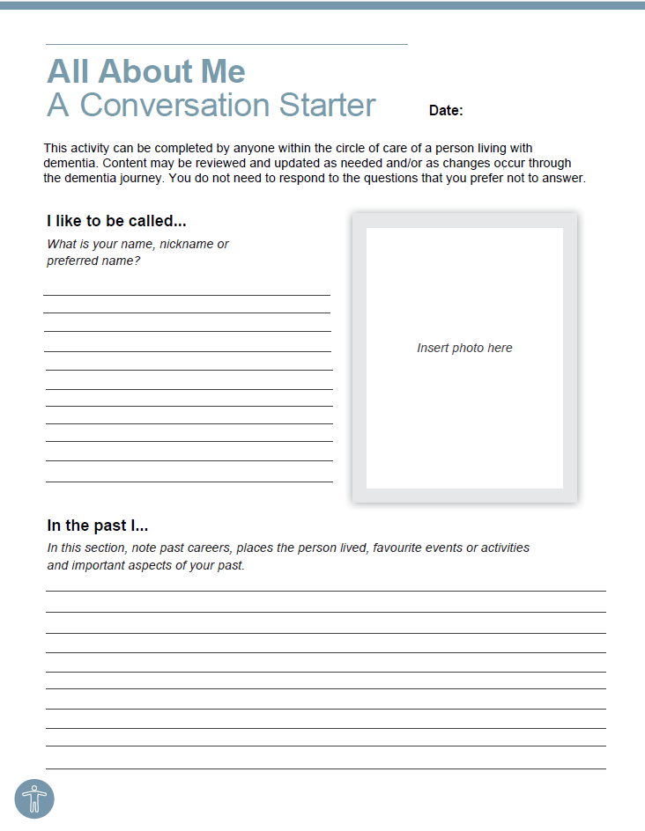
KEY FEATURE #3
All About Me
All About Me outlines the Circle of Care
Preferences
Behaviours
History
Interests

Slide 16
4. Access dementia care resources
(includes resources for cultural communities such as First Nations, French-speakers, and South Asian)
“I think that’s a good idea to have that to it right at your fingertips and you don’t have to search for anything.” - Caregiver
“Because a lot of times, resources, by the time you figure out what resources are there, you’re in the next stage of the journey” - Caregiver

Slide 17
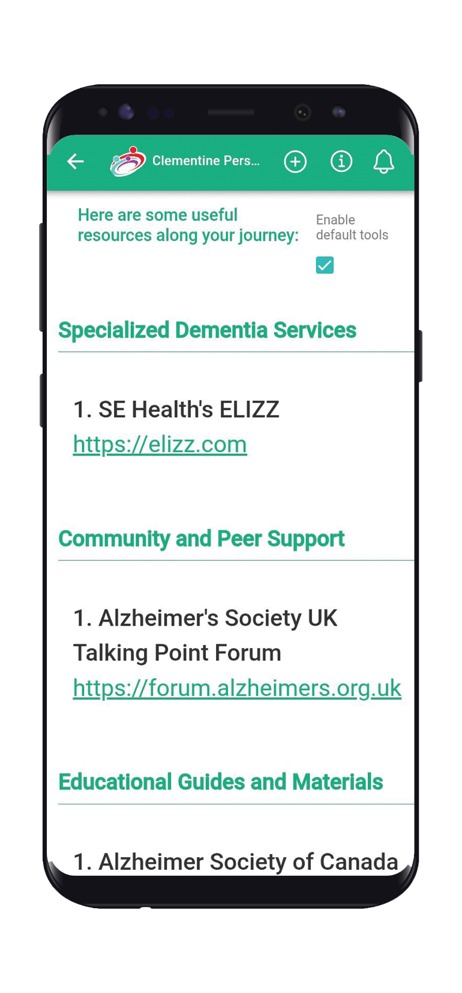
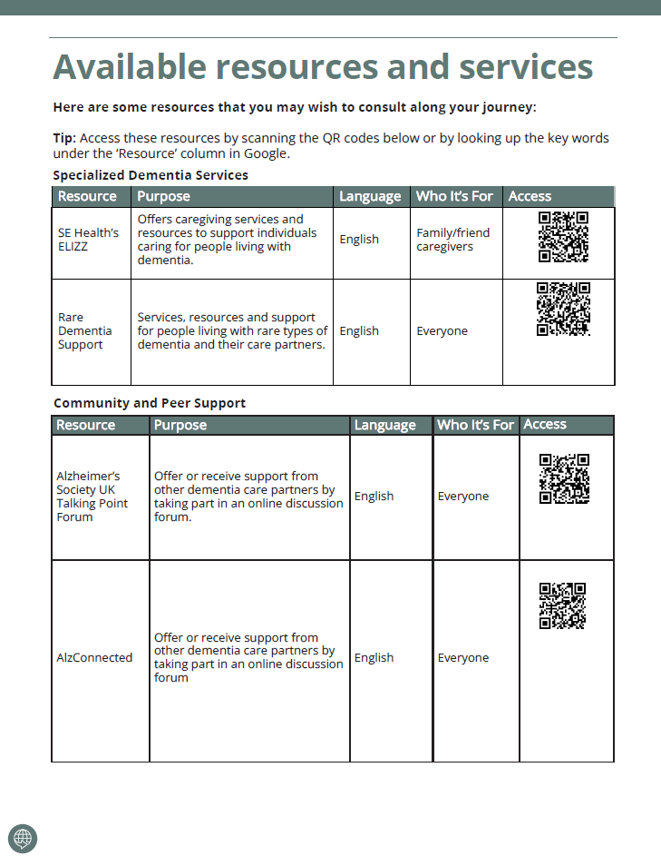
KEY FEATURE #4
Resource Section
The Resource Section
Standard list of resources
Upload your own resources as links, files, or pictures

Slide 18
5. De-stigmatize dementia through conversations
“… Everyone feels like you’re alone in this whole thing, right? And this whole process.
So, when we start talking about resources that are available, then everybody sits up and listens. And also it’s good to know how each one manages their day. … this app also kind of draws us closer together…“. - Caregiver

Slide 19
NEXT STEPS
Visit our website to explore the ODJJ further
If you’d like to share/promote ODJJ to Your Community or Organization, visit our resource page
If you’d like to access resources to implement or use the ODJJ with your organization, community or group, visit our website.

Slide 20
Thank you

